Slide 1
Chapter 1
Part 1

Slide 2
Scientific Notation
When writing out numbers with many digits, spacing in groups of three will be used.
No commas
Standard international notation
Examples:
25 100
5.123 456 789 12
Using Scientific Notation (Powers of 10): Common to express very large or very small numbers using powers of 10 notation.
Examples:
39,600 = 3.96 × 10⁴
(moved decimal 4 places to left)
0.0021 = 2.1 × 10⁻³
(moved decimal 3 places to right)
Standard form or scientific notation is used to express magnitude in a simpler way. In scientific notation, a numerical magnitude can be written as : A x 10^{n}, where 1 ≤ A < 10 and n is an integer (+ or – sign).

Slide 3
Scientific Notation
The number of atoms in 12 g of carbon:
602,200,000,000,000,000,000,000
The mass of a single carbon atom in grams:
0.0000000000000000000000199
N is a number between 1 and 10
n is a positive or negative integer

Slide 4
Scientific Notation
Using Scientific Notation
A x 10^{n}, where 1 ≤ A < 10 and n is an integer
Example: For each of the following, express the magnitude using a scientific notation.
A- 20000000
B- 345000
C- 0.0000023
D- 0.00000006
E- 123402123100
Solution:
A- 2 x 10⁷
B- 3.45 x 10⁵
C- 2.3 x 10⁻⁶
D- 6 x 10⁻⁸
E- 1.2 x 10¹¹

Slide 5
Scientific Notation
Mathematical Manipulation:
The multiplication
Example

Slide 6
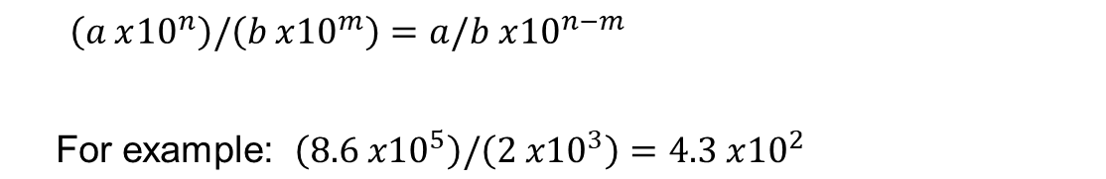
Scientific Notation
Mathematical Manipulation:
The division
Example

Slide 7

Scientific Notation
The addition and subtraction
You should conjugate the power (the order) of the numbers during you make adding or subtracting
Example

Slide 8
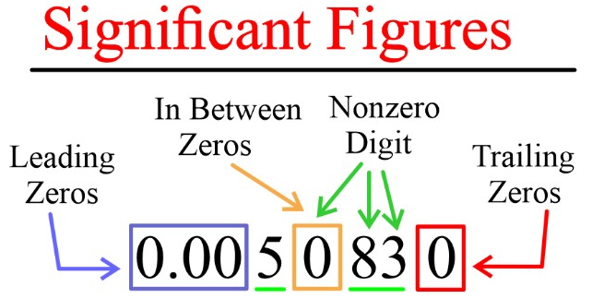
Significant figure
Significant figures in a measurement include all of the digits that are known, plus one more digit that is estimated.
Measurements must be reported to the correct number of significant figures.

Slide 9
Significant figure properties
All numbers that are not zeros are significant.
For example 1.57 has 3Sig.
- 37 → 2 sig
- 5006 → 4 sig 7030 → 3 sig
- 4,0000 has 1Sig.
700000 has 1Sig.
Zeros in the middle of non-zero numbers are significant
- For example 5.004 has 4Sig. While 5,400 has 2Sig.
- 703 → 3 sig
All numbers and Zeros before and after decimal are significant
- For example 27.200 has 5Sig.
- 7030.10 → 4sig
Not counting

Slide 10

Significant figure properties
Zeros in the beginning are not significant
For example 0.00020 has 2Sig
0.0004 has 1Sig
Zeros and coefficients in scientific notation are significant
For example 2.0 × ${10}^{6}$ has 2Sig
3,004 × ${10}^{−2}$ has 4Sig

Slide 11
Significant figure
Check point
How many significant figures in the following?
1.0070 m → 5 sig figs
17.10 kg →4 sig figs
100,890 L →5 sig figs
3.29 x 10³ s →3 sig figs
0.0054 cm →2 sig figs
3,200,000 mL →2 sig figs

Slide 12
Operations with Significant Figures – Multiplying or Dividing
When multiplying or dividing several quantities, the number of significant figures in the final answer is having the smallest number of significant figures.
Example: 25.57 m x 2.45 m = 62.6 m²
The 2.45 m limits your result to 3 significant figures.
Example

Slide 13
Operations with Significant Figures – Adding or Subtracting
The rule for addition and subtraction are different than the rule for multiplication and division.
For adding and subtracting, the number of decimal places is the important consideration.
When numbers are added or subtracted, the number of decimal places in the result should equal the smallest number of decimal places of any term in the sum.
For example, if we wish to compute 123 + 5.35 the answer is 128 and not 128.35
But if compute 123.1 + 5.32 the answer is 128.4
Example
66.59 – 3.113 = 63.477 round to 63.48

Slide 14
Units and measurements
A quantity that can be measured.
A quantity has numerical value and suitable unit of measurement.
For example, temperature 30 degrees Celsius, 30 is numerical value & ‘degree Celsius’ is the unit and can be written as 30º C..
Quantity | SI Unit
Length | meter
Mass | kilogram
Time | second
Temperature | Kelvin
Electric Current | Ampere
Luminous Intensity | Candela
Amount of Substance | mole

Slide 15
Units and measurements
Quantities are classified as
- Basic (fundamental) quantities
- Derived quantities
1- Three basic (fundamental )quantities are:
Length
Mass
Time
All other quantities can be expressed in terms of the three fundamental quantities
2- Derived quantities can be expressed as a mathematical combination of fundamental quantities.
Examples:
Area
A product of two lengths
Speed
A ratio of a length to a time interval
Density
A ratio of mass to volume

Slide 16
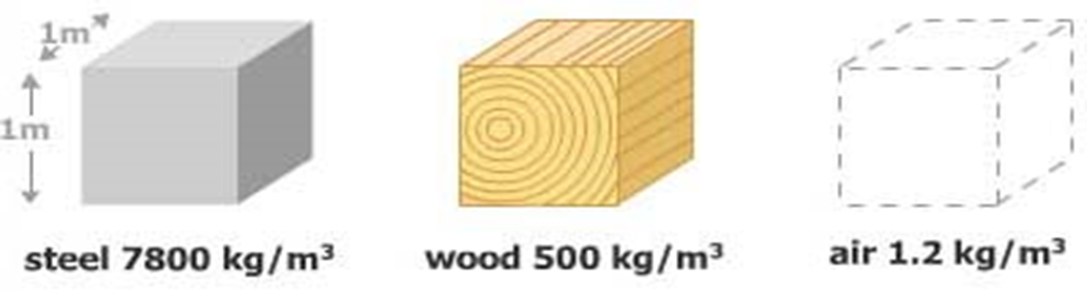
Units and measurements
Density: Amount of mass per unit volume of a substance.
SI Units: kg/m³
Common Units: g/cm³ or g/mL

Slide 17
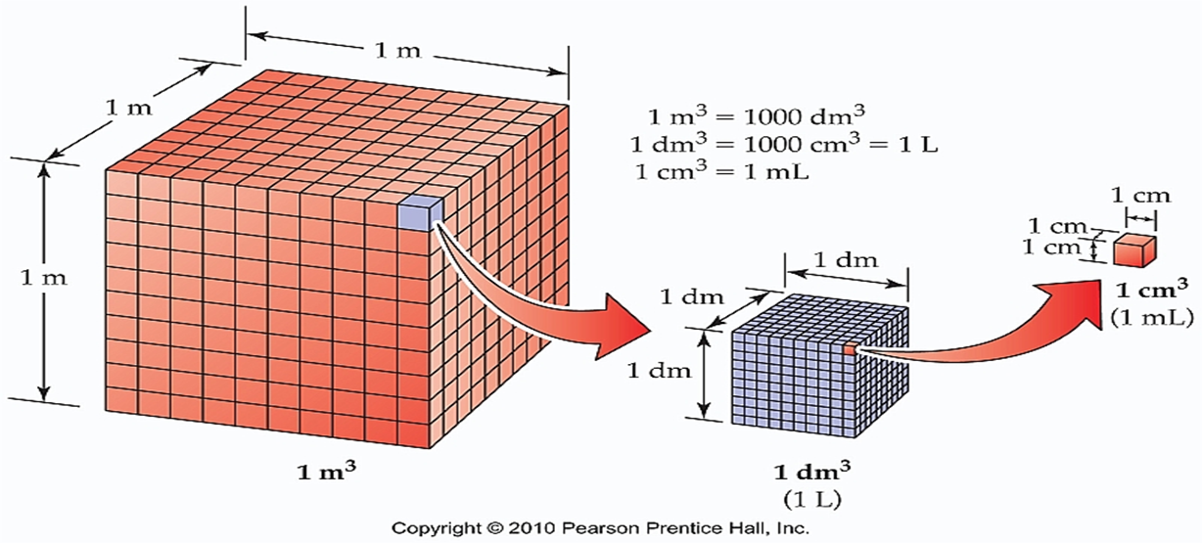
Units and measurements
Volume: Amount of space occupied by a body.
SI Unit: cubic meter (m³)
Common Units: Liter (L) or milliliter (mL) or cubic centimeter (cm³)

Slide 18
Conversion of Units
When units are not consistent, you may need to convert to appropriate ones.
See Appendix A for an extensive list of conversion factors.
Units can be treated like algebraic quantities that can cancel each other out.

Slide 19
Example: If a car speed is 130 km/h. Express this speed in meters per second.
SOLVE: We use the conversion factors with the problem solving strategy:

Slide 20
Conversion
Always include units for every quantity, you can carry the units through the entire calculation.
Will help detect possible errors
Multiply original value by a ratio equal to one.
Example:
Note the value inside the parentheses is equal to 1, since 1 inch is defined as 2.54 cm.
1in = 2.54 cm

Slide 21
Example:
The highest waterfall in the world is Angel Falls in Venezuela, with a total drop of 979.0 m (see Figure). Express this drop in feet.
Solution:
Since 3.281 feet = 1 meter, it follows that (3.281 feet)/(1 meter) By using this factor of conversion
1m = 3.281 feet

Slide 22
Is He Speeding?
On an interstate highway in a rural region of Wyoming, a car is traveling at a speed of 38.0 m/s. Is the driver exceeding the speed limit of 75 mi/h or 120 km/h?
1 mi = 1609 m
1 mi = 1.609 Km

Slide 23
Is He Speeding?
On an interstate highway in a rural region of Wyoming, a car is traveling at a speed of 38.0 m/s. Is the driver exceeding the speed limit of 75 mi/h or 120 km/h?
SOLUTION
Convert meters in the speed to miles:
Convert seconds to hours:
1 mi = 1609 m
Convert miles to kilometers:
1 mi = 1.609 Km
The driver is indeed exceeding the speed limit and should slow down.

